Slide 1
FUNMAT PRO 610 HT Site Preparation Guide
INTAMSYS
2022-06

Slide 2
Agenda
0 1
Physical specification and space requirements
0 2
Workstation requirements
0 3
Accessories
0 4
Consumables and Maintenance Parts

Slide 3
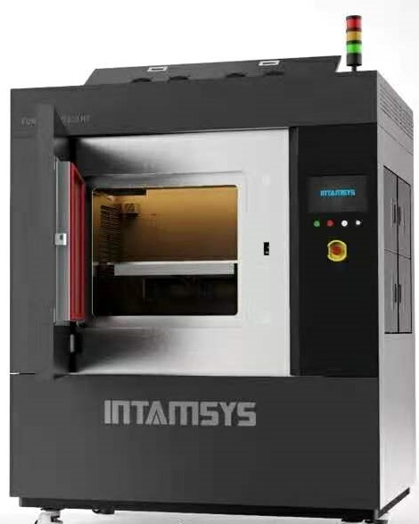
Physical specification and space requirements
 | Size | Weight
Printer | 1710*1440*2080 mm (With Light tower 1710*1440*2350mm) | 1450Kg
With Box | 1850*1450*2150 mm | 1830Kg
Environmental Requirements
Operating Temperature | 15~30°C
Operating Humidity | 30%~70%
Storage Temperature | -10°C~50°C
Input | 3P5W 380V 30A/phase, 50~60Hz
Air Supply | ≥0.7Mpa, Ø10 Quick connector Dry and clean air
Max. Power | 15kW
Note: For indoor use only.
The Casters should be only used for short-distance transport

Slide 4
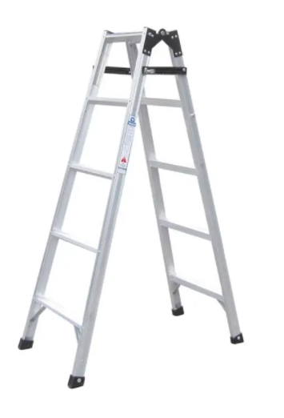
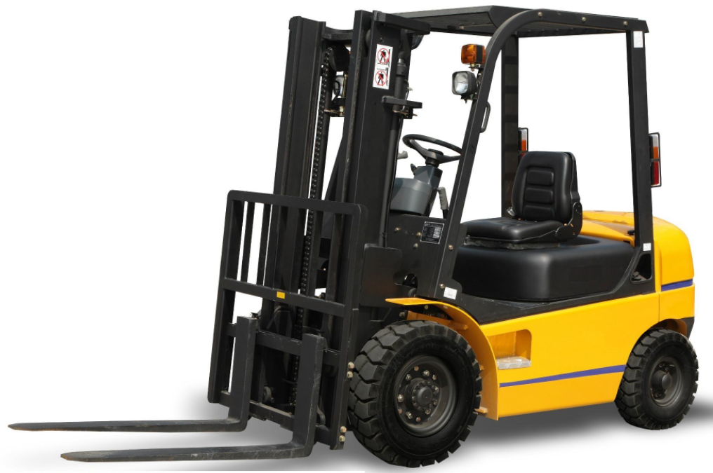
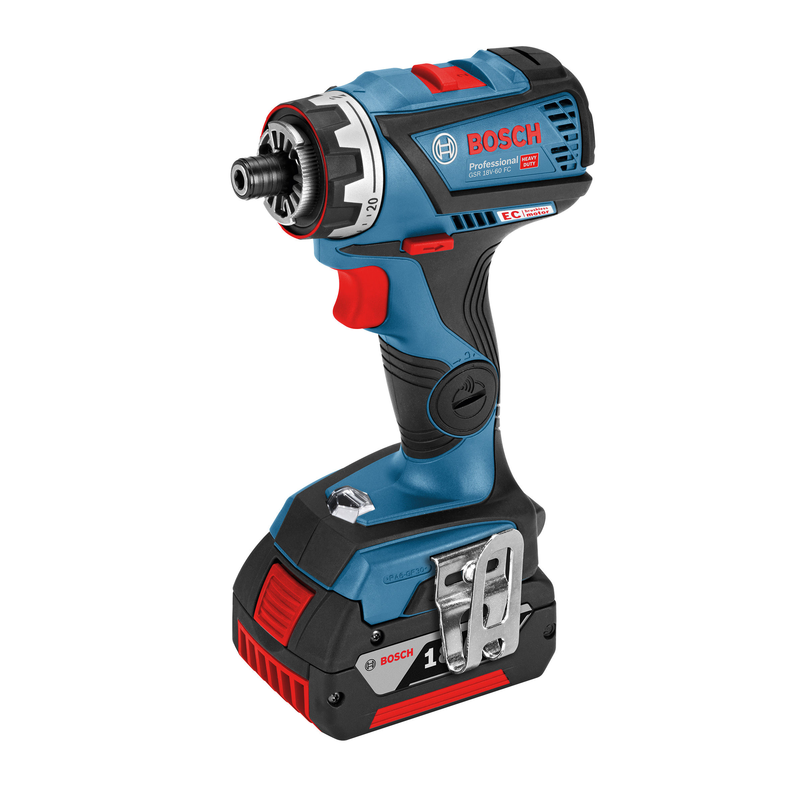
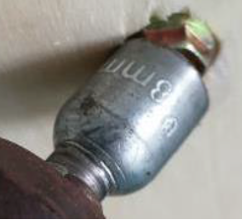
Physical specification and space requirements
Recommended Tools:
Forklift truck （3ton）
Electric drill
8mm socket with adapter
Knife
Ladder
Unloading space requirements
Should be a level surface
Enough space for the forklift to remove the printer from the delivery truck
Enough space required for unpacking the printer
4450mm
1450mm
1450mm
1550mm
Printer with Crate
Printer
Forklift truck

Slide 5
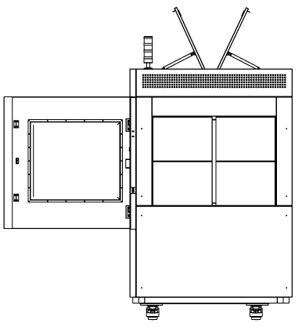
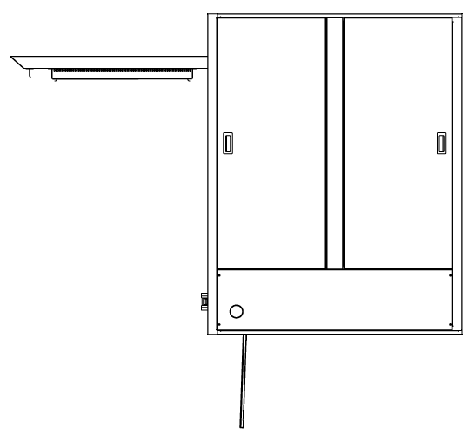
Physical specification and space requirements
3000
1350
800
800
1050
1450
300
800
300
1710
3310
Maintaining Space
2080
2600
500
800
Working Space
Working Space
3500
3500
Note: All dimensions in mm

Slide 6
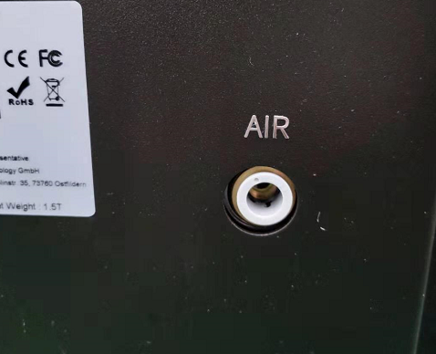
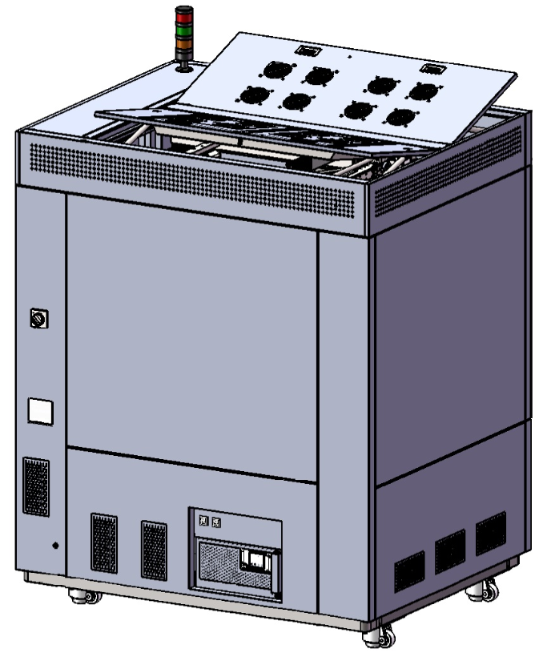
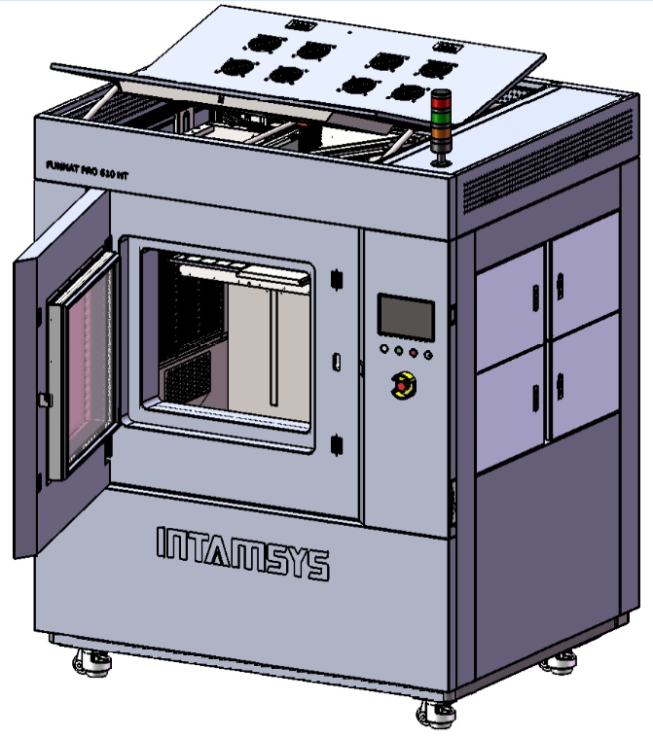
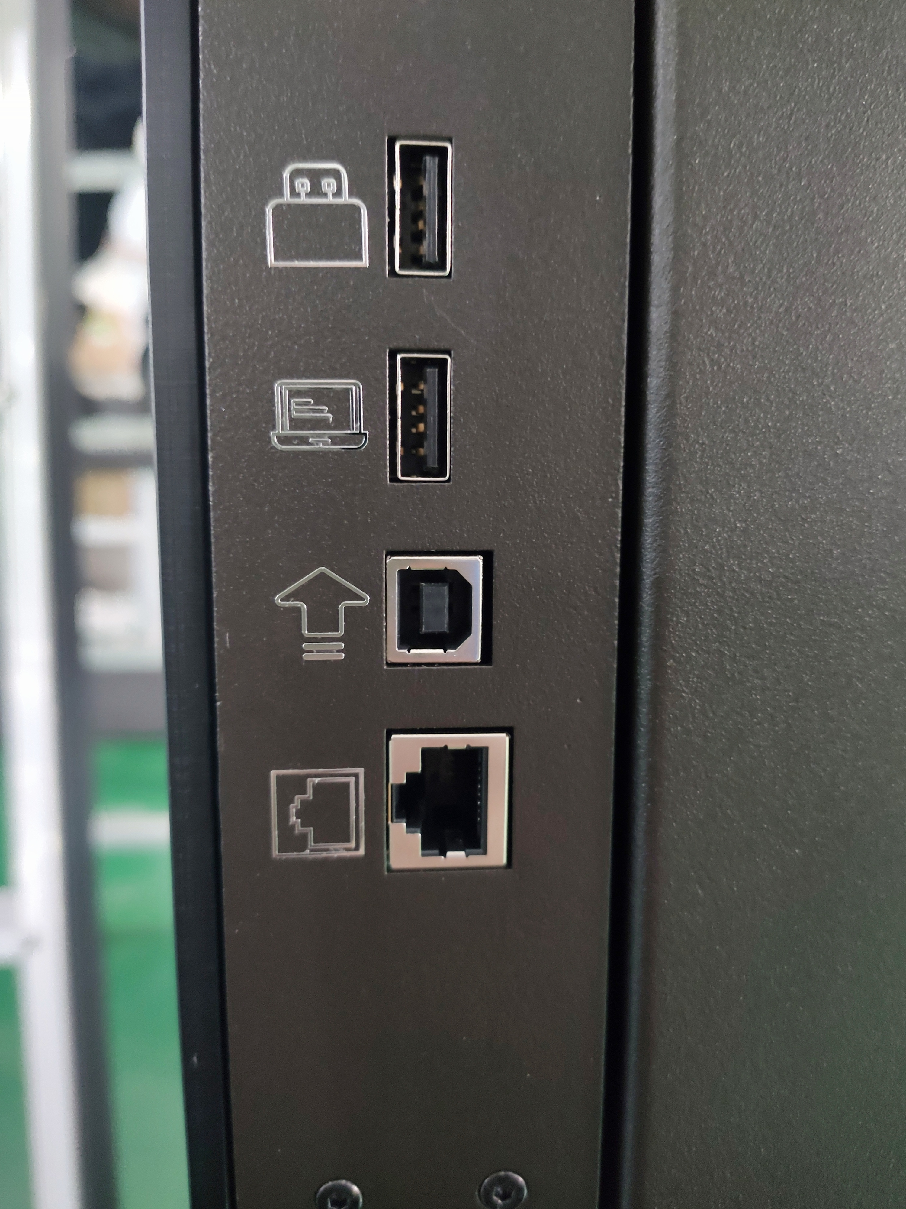
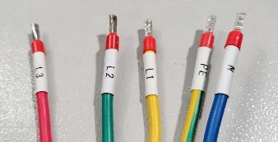
Physical specification and space requirements
USB Flash Disk Port
USB Printing Port
Compressed Air Inlet
FW Upgrade Port
Ethernet Port
Main Power Cable
（ take the cable with10m length out from the neath of printer）

Slide 7
Workstation requirements
Computer Type | Standard desktop PC
Operating system | Window 7 or later, 64-bit
CPU | Intel Core 2 or AMD Athlon 64 processor; 2GHz or faster processor
RAM | 4GB for 64-bit operating system
Hard disk | 2GB or more of available hard-disk space
Monitor graphics resolution | 1280×800 display with 32-bit color and 512 MB or more of dedicated VRAM
Video card | OpenGL 2.0 or newer capable graphics card

Slide 8
Accessories
Cooling Liquid (more than 1800ml, car coolant is recommanded)
Recommended Accessories (depending on processed Materials):
Air compressor and compressed air dryer
Programmable oven (min. 150°C)
Hand & Eye wash basin
Tools for remove support filament (Pliers, Knife, Brushes,..)
Ultrasonic cleaner with heating function for removing soluble support material
Sealed glass container for removing support material with Limonene
Sealed glass container for softening support material with Ethyl acetate
Gloves
Masks
Safety Glasses

Slide 9
Consumables and Maintenance Parts
Consumables
Nozzle
Nozzle Heater Assemble
Nozzle Cleaning Brush
Buildplate’s
PC Plate
PEI Painted Steel Plate
Stainless Steel Plate
Buildplate Glue
Chamber Air Filter
Maintenance and wear parts
Grease (high temp, PFPE)
Filament Tube
Cooling Liquid Pipe
Chamber Lamp
Chamber Air Filter
Chamber Heating Tube
Collecting Tube Assembly
Other Small Parts

